Slide 1
Verification, Validation

Slide 2
Motivation
Specification
Hardware and Software
Optimization
Ultimately, we need to test if our design-development is correct, if it gives us the expected output for the given inputs

Slide 3
Ways to Validating a Design
Stimulating different paths
Input
Simulation based methods
We run a model, given some inputs (test vectors) and outputs
We check if the outputs are the expected ones.
Need to check ALL possible of inputs and outputs
Semi-Formal Methods
i/o specified as symbolic expression
Formal Methods
Requires logic to proof certain matters
Equivalence Checking
Specification → Design Process → Implementation [does implementation = specification?]
Model Checking
Theorem Proving
Output

Slide 4
Simulation Based
Specification
DUT = Design Under Test
S = Stimulus Generator
M = (Output) Monitor
Challenges / Drawbacks:
Generate ALL possible stimulus (input-output)
We may limit our focus to only Critical Paths
But still large
Time Consuming
Advantages :
Easier to perform
Only setup the simulation
S
DUT
(Hardware (i.e. HDL), Software (i.e. C), or Both )
M

Slide 5
Simulation & Testbench Authoring Language (TAL)
TAL : Jeda, Vera, testBuilder
Testbench: Set of i/p to get the desired o/p
Testbench Coverage:
Set of i/p that covers the whole o/p
See next slide for example

Slide 6
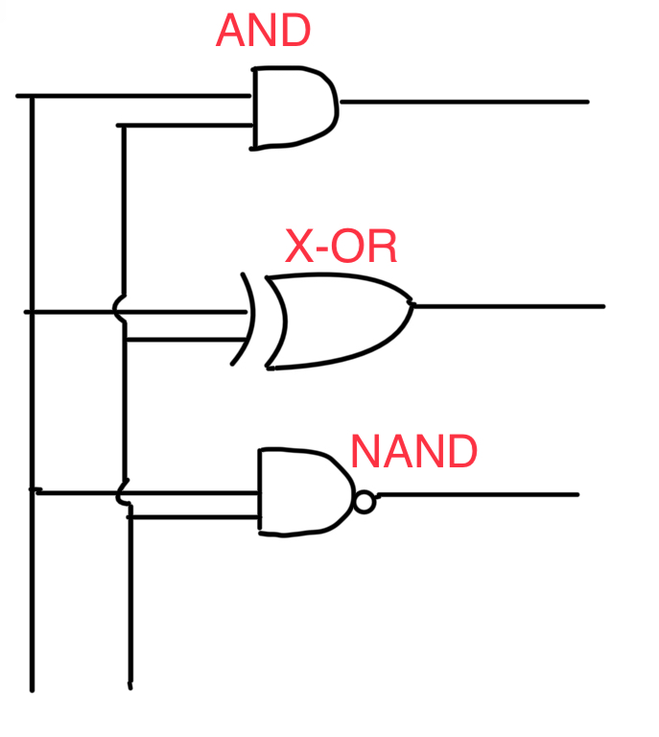
Testbench Coverage - Example
System includes 3 Gates
Inputs→ | 00 | 01 | 10 | 11
AND | 0 | 0 | 0 | 1
XOR | 0 | 1 | 1 | 0
NAND | 1 | 1 | 1 | 0
2 input Channels: combinations: 00, 01, 10, 11
10 & 11 covers all parts getting output 1

Slide 7
Formal Methods
Equivalence Checking
Original Model/Specification vs Synthesized/Optimized Model
Model Checking
Given some properties, does the model satisfy the properties?
Theorem Proving
Prove that the implementation is equivalent to the model

Slide 8
Equivalence Checking

Slide 9
Logic Equivalence Checking - A Concept
Input
1
2
Output
Input
1
2
Output
System 1
Are they Equal?
System 2

Slide 10
FSM Equivalence Checking
FSM are defined: <I, O, Q, Q₀, F, H>:
I = set of all Inputs, O = set of all Outputs, Q=set of all states, Q₀ = set of all initial states, F = state transition functions (given by delta ẟ(source state, destination state)), H = set of final states
Given 2 models, determine if they are equivalent:
M1: <I, O₁, Q₁, Q₀₁, F₁, H₁>
M2: <I, O₂, Q₂, Q₀₂, F₂, H₂>
Notice that, the inputs I will be the same for both of the models

Slide 11
FSM Equivalence Checking - Algorithm
For a couple of given FSMs (M1, M2):
Find all the state pairs (Q₁ x Q₂)
For every state pairs, and for each input, find the transitioned (destination) state pairs
Check if :
The outputs match
transitioned (destination) states in a pair are either both final states or both non-final states.
If not, then these 2 models are not equal

Slide 12
FSM Equivalence Checking - Algorithm Example
p
r
List all the inputs
a/x
 | a | b
{p, r} | {q,s} | -
{p, s} | - | -
{p, t} | - | -
{q, r} | - | -
{q, s} | - | {q, t}
{q, t} | - | {q,s}
a/x
s
b/y
q
b/y
All State Pairs (Q₁ x Q₂)
b/y
t
FSM 1
FSM 2

Slide 13
Model Checking

Slide 14
Model Checking - the one with properties
Ways to write properties: if P is a property
For all, (there exists) P: (∀ P) ⇒ for every path, there will be P
For some, (there exists) P: (∃ P) ⇒ for some path (at least one), there will be P
Always P: (G P) or ( ◻ P) ⇒ this property will always be satisfied no matter where we are on whatever path
E.g.: Always state-3 will follow state-2
Eventually P: (F P) or (♢ P) ⇒ whatever path we take, we will eventually reach P

Slide 15
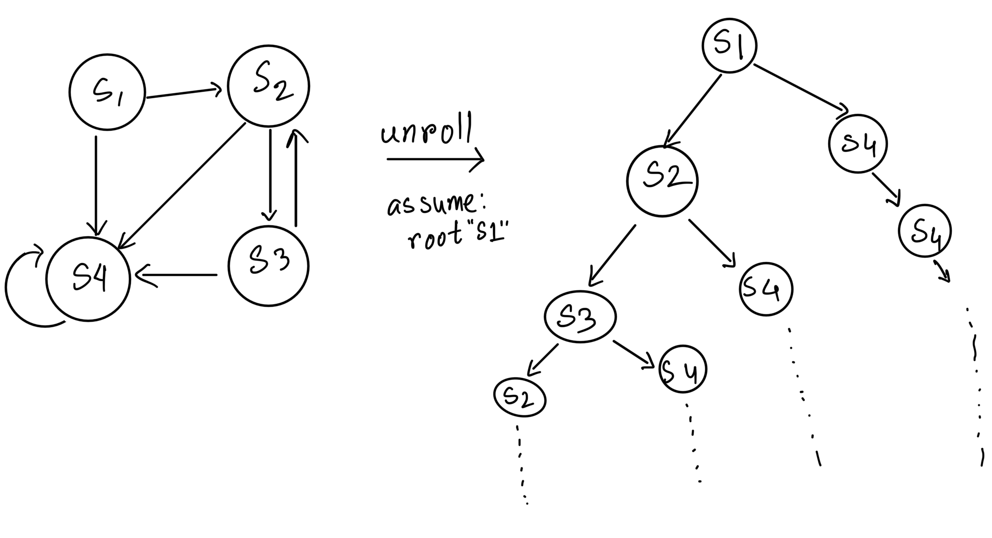
Model Checking - Example

Slide 16
Model Checking - Example
For all path, there will be S2
False
For some path, there will be S2
True
Always S3 will follow/succeed S2
True
Eventually we will reach s4
False

